Slide 1
Finance Papers
DSG Budget 2026/27

Slide 2
Schools Forum
To note the allocations of the Dedicated Schools Grant as detailed in the report
To note the top slice from school’s block £1.394m
To support recommendations for funding formula on school’s block
To support recommendations for the Early Years funding rates to providers
To support the value of the Growth Fund
To note the 2026/27 HNB deficit of a£9.966m giving a cumulative deficit across all blocks at the end of 2026/27 of £33.956m.
To note the 3 appendices with school level detail – currently confidential papers

Slide 3
Schools Block – National Context
The changes to the Schools Block for 2026-2027 are as follows.
A 3.2% increase for Primary and a 2.2% increase for Secondary has been applied to the Minimum funding levels per pupil, set as part of the NFF. The increase is related to the mainstreaming of the two grants into the funding base.
National Insurance contributions (NICs) grant
Schools budget support grant (SBSG),
The 2026-2027 DSG allocations reflect the continued change in the process for national non-domestic rates whereby the DfE will pay billing authorities directly for both academy and maintained schools.
A separate grant will fund the extension of Free School Meals (FSM) to all Universal Credit households from September 2026; it will be paid in addition to the main funding blocks. (Value to be announced)

Slide 4
Schools Block - National funding formula (NFF) 2026 to 2027

Slide 5
Early Years Block - National Context
For 2026 to 2027, there are 2 key adjustments to funding local authorities:
funding provided through the 2025 to 2026 early years national insurance contributions and teachers’ pay grant (EYNTPG) has been rolled into the national average funding rate for 3 and 4-year-olds, 2-year-olds and 9 months to 2-years-old as stated in section 1.3. The DfE stated that in including this grant funding at national level, the government have reflected their scope of the 2025 to 2026 EYNTPG and have streamlined their approach to rolling funding in, compared to equivalent teachers' pay funding in previous years.
from financial year 2026 to 2027, the government are introducing a termly census headcounts, bringing the whole Early Years count process in line with the existing process for the working parents’ entitlements for 2-year-olds and under. To be noted for the first time moving away from participation funding calculated on January census for three- and four-year-olds and additional support 2-year-olds (the two original formula entitlements)
Funding for the early years entitlements is based on part-time equivalent (PTE) hours. Defined as 1 PTE is 15 hours across 38 weeks a year (that is, 570 funded hours per annum) no change for 2026-27.
For 2026 to 2027, the government are increasing the minimum pass-through rate to 97% (from 96% in 2025 to 2026).

Slide 6
SEND/High needs block – National Context
Government have indicated they will be transferring the cost of SEND to Central Government from 2028/29 this will have by far the largest impact on local authority funding. There are still no firm proposals for existing deficits or short-term costs.
For the 2026-2027 financial year, the UK government has suspended the national high needs funding formula, basing allocations on 2025-2026 figures with adjustments, and will review the methodology later to align with SEND reforms.
The DfE are also continuing the maintained special schools and special academies protection arrangements (known as the minimum funding guarantee or MFG) in 2026-27, using the 2025-26 allocations of place and top-up funding as the basis for the year-on-year calculation

Slide 7
DSG Allocations
The 2026-27 allocation for the DSG is £396,232m and is made up of four blocks of funding:
Schools Block £278,787m (included the Mainstream Schools Additional Grant and £1.721m NNDR)
Central School Services Block £2.355m
High Needs Block £67.5746m (included is the core school budget grant £3.59m and enhanced resource units Schools budget support grant and national insurance grant £0.094m)
Early Years Block £47.917m

Slide 8
School Block Local Context
The School’s Block in 2026-27 has increased by £12.032m from the 2025-26 allocation. A 4.51% increase due to mainstreaming the school budget support grant (SBSG) and the National Insurance contributions (NICs) grant. Excluding the grants the increase is 2.59% a significant impact on the allocation is the reduction in the number of pupils at census of 477 (£3.102m) from 2025-26 noted 4.6.
Derby has funded schools at 100% NFF levels for several years
Derby’s affordability calculation continues to be affected by a significant increase in the number of students eligible for free school meals

Slide 9
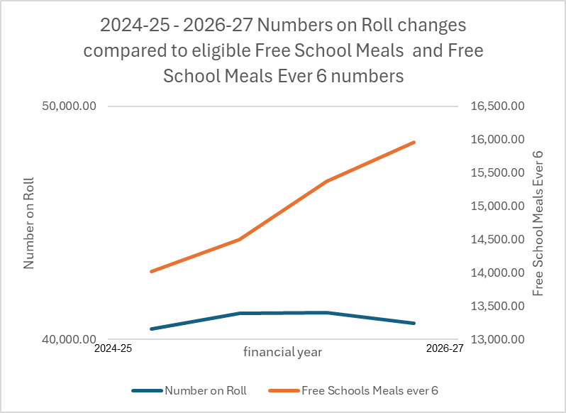
School Block - Free School Meals
Although Derby’s has a favourable MFL position, Derby’s affordability calculation continues to be affected by a significant increase in the number of students eligible for free school meals (FSM) and those who have been eligible in the past six years ‘'ever’' FSM). The table below shows that more students are eligible even though the total number of pupils has reduced.

Slide 10
School Block – Minimum Funding Levels (MFLS)
Derby’s average percentage increase per pupil continues to increase a real positive for Derby’s schools. The per pupil increase within the block is 5.8% with an overall 4.5% increase in Derby’s School’s budgets (as identified in appendix 1).
Notwithstanding the mainstreaming of the 2 grants Derby’s per pupil amount is on average 23.6% greater than the MFL set for primary and on average 22.8% for secondary pupils, with some schools receiving 55% above the MFL. No Derby schools are set to receive the basic MFL as stated by the DfE. Note 4.8

Slide 11
Schools Block -£278,787m
The following set of principles will be applied to Derby’s Schools Block Funding Formula for 2026-27
Implementation of the National Funding Formula rates in the local funding formula. Derby currently mirrors rates set by DfE at 100%.
A Minimum Funding Guarantee set at 0% (per pupil funding protection mechanism), the most favourable percentage for schools. This applies to only 4 schools (down from 14 the previous year); a positive position as all schools are funded at the NFF levels and the MFG is set at the maximum amount allowable in the regulations.
A transfer of £1.394m (0.5%) to the High Needs Block. Schools Forum have the powers to approve a transfer of up to 0.5% from the Schools Block to other areas of the DSG. The amount requested for 2026-27 is within the permitted limit.
A cap on growth above 2% (up from 0.5% in 2025-26), scaling back of 67.37% (again more favourable from 85.4% 2205-26). Such a requirement is necessary due to the funding challenges arising from both below inflation allocation increase and greater take up of free school meals (FSM).

Slide 12

School Budget – Capping & Scaling – explained
This particular mechanism helps to prevent excessive year-on-year funding increases (gains) for some schools, allowing for a more even distribution of available funds across all schools in the area. This means that schools with the largest potential gains under the funding formula have those gains limited ("capped") and partially redirected ("scaled") for wider distribution. (Affects those with the largest gains)
Capping – maximum limit on a percentage gain
Scaling – is applied to the amount of gain received above the set cap
In 25/26 A cap on growth above 0.5%, scaling back of 85.4%.

Slide 13
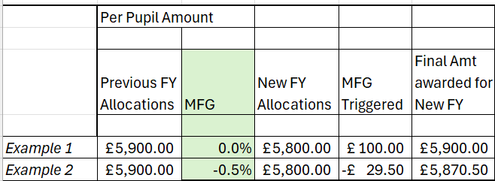
School Budget MFG explained
Minimum funding levels/ Minimum funding guarantee This a mechanism used in the school funding formula to ensure that schools do not experience a significant reduction in their per-pupil funding year-on-year. The lower the set threshold the more money is release back into the formula , (affects those with year on year reductions)
In 25/26 0% was applied and 14 schools were on the MFG

Slide 14
Pupil Premium
Pupil premium funding rates for the financial year 2026-2027 have been announced. These rates are increasing by 2.23%, in line with the GDP deflator measure of inflation.
primary FSM6 pupils: £1,550
secondary FSM6 pupils: £1,100
looked-after children: £2,690.
children who have ceased to be looked-after £2,690.
service children £360

Slide 15
Central School Services Block £2.355m
The Central School Services Block continues to be reduced. For 2026-2027 the reduction is circa £0.110m.
Central Services Block continues to support historic commitments.
To Note Derby City Council general fund pays all borrowing costs as a result of the DSG deficit.

Slide 16
Early Years Block £47.917m
The main principles adopted by Derby City for allocating funding to providers is as follows,
Passport maximum affordable funding as a priority to all qualifying providers. (minimum 97% based on DfE passport tool)
Create contingency fund in line with DFE guidelines.
Create inclusion funds for all age ranges in line with DfE guidelines.
Passport as directed both Disability Access Fund and Pupil Premium
Top slice for each category to provide support for children with additional and emerging special educational needs, improving school readiness and a positive transition into primary school. This will be additional to the EYIF funded through the High Needs Block.

Slide 17
Early Years Block
Provider hourly rates are as follows
3 and 4-year-olds base rate of £5.79 an increase of £0.27per hour (4.89%).
Additional Support 2-year-olds of £8.42. per hour this is an increase of £0.32 per hour (3.95%).
Working parent 2-year-olds of £8.42 per hour this is an increase of £0.32 per hour (3.95%).
Working parents 9 months to 2-year-olds of £11.46 per hour this is an increase of £0.30 per hour (2.69%.)
Early Years Pupil Premium (EYPP): The rate will increase by 15% to £1.15 per hour per eligible child (approx. £655.50 per year).
Disability Access Fund (DAF): The annual flat-rate payment for eligible children will rise to £975.
Maintained Nursery Schools (MNS): Supplementary funding minimum hourly rates have increased to £5.47, with a cap of £10 per hour.

Slide 18
High Needs Block £67.5746m
2026-27 sees the mainstreaming of the grants detailed in section1.3 into the HNB – in essence the base allocation for 2026-27 is cash flat.
Derby has suffered a pressure of £3m due to the decision made on the methodology of the HNB allocation – made up of the following
No inflation (based on 3% assumption) £1.8m
Suspension of HNFF £0.7m mainstreaming of grant
October 24 census not then recognising Derby’s planned growth £0.5m)
Reporting an in year deficit forecast in 2026/27 of £9.966

Slide 19
In Conclusion
To note the allocations of the Dedicated Schools Grant as detailed in the report
To note the top slice from school’s block £1.394m
To support recommendations for funding formula on school’s block
To support recommendations for the Early Years funding rates to providers
To support the value of the Growth Fund
To note the 2026/27 HNB deficit of a£9.966m giving a cumulative deficit across all blocks at the end of 2026/27 of £33.956m.

