Slide 1

Join the Travel Smart Superheroes
Get active,
help beat the chaos caused by traffic
and play your part to save the planet one school journey at a time!

Slide 2

Smilers Ways to Wellbeing
The SMILERS Ways to Wellbeing
Stay Connected. Having healthy relationships with people, pets and nature to help you to feel happy.
Move. Being active releases chemicals in your brain which boosts your mood and makes you feel good.
Interest. Having special interests and learning something new to help keep your brain busy.
Look. Using your senses to notice what is around you to keep you in the moment.
Eat well. Eating a balanced diet to make you feel good and help you stay healthy and strong.
Rest. Getting a good night’s sleep to improve your memory, mood and mental health.
Support. Supporting others to make us feel positive and to make them happy too!

Slide 3

Ways to make a journey
Ways to Travel Smart
for a happier, healthier, safer, cleaner and greener school journey!
Walk or Wheel
Follow the SMILERS and make a
Travel Smart superhero journey!
Carshare
Bus or Train
Cycle or Scoot
Park and
Stride or Glide

Slide 4














Stay connected on Mighty Movers Monday
You could work alone, but working together is so much better!
Think of words to describe your superheroes and their team name.
Here are words to help – or can you think of any others?

Slide 5



Move more on Super Shoesday
Rider
Stroller,
Strider,
Dasher,
Hiker
Gilder,
Zoomer,
Biker,
Roller,
Wheeler
How ever you move, don’t forget to put on your fabulous footwear, brilliant boots, wonderful wellies, splendid shoes
or tremendous trainers!

Slide 6
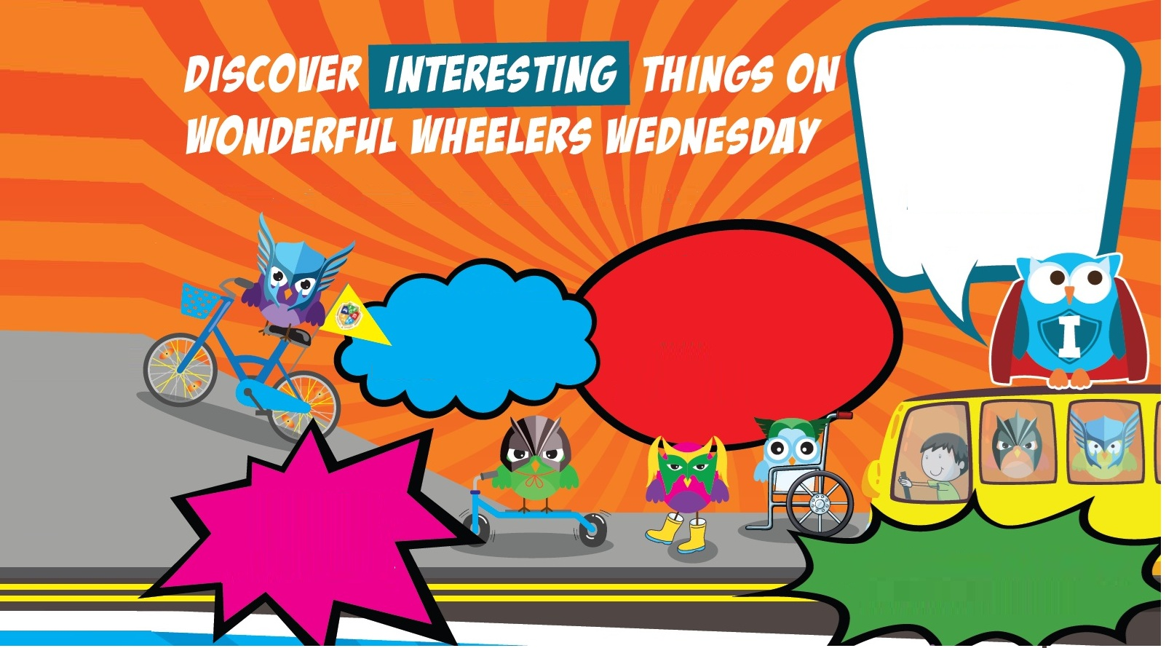
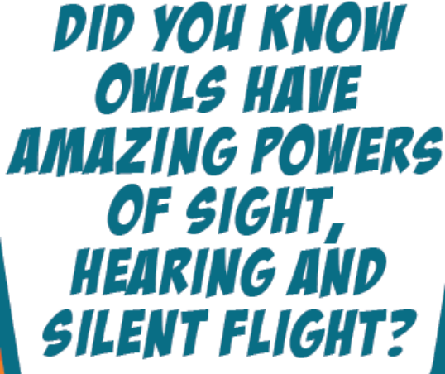




Discover interesting things on wonderful wheelers Wednesday
Describe your Travel Smart superhero powers.
for the whole journey or parking and then striding.
for climbing steep hills.
for effortless gliding.
for carshare or bus riding.

Slide 7
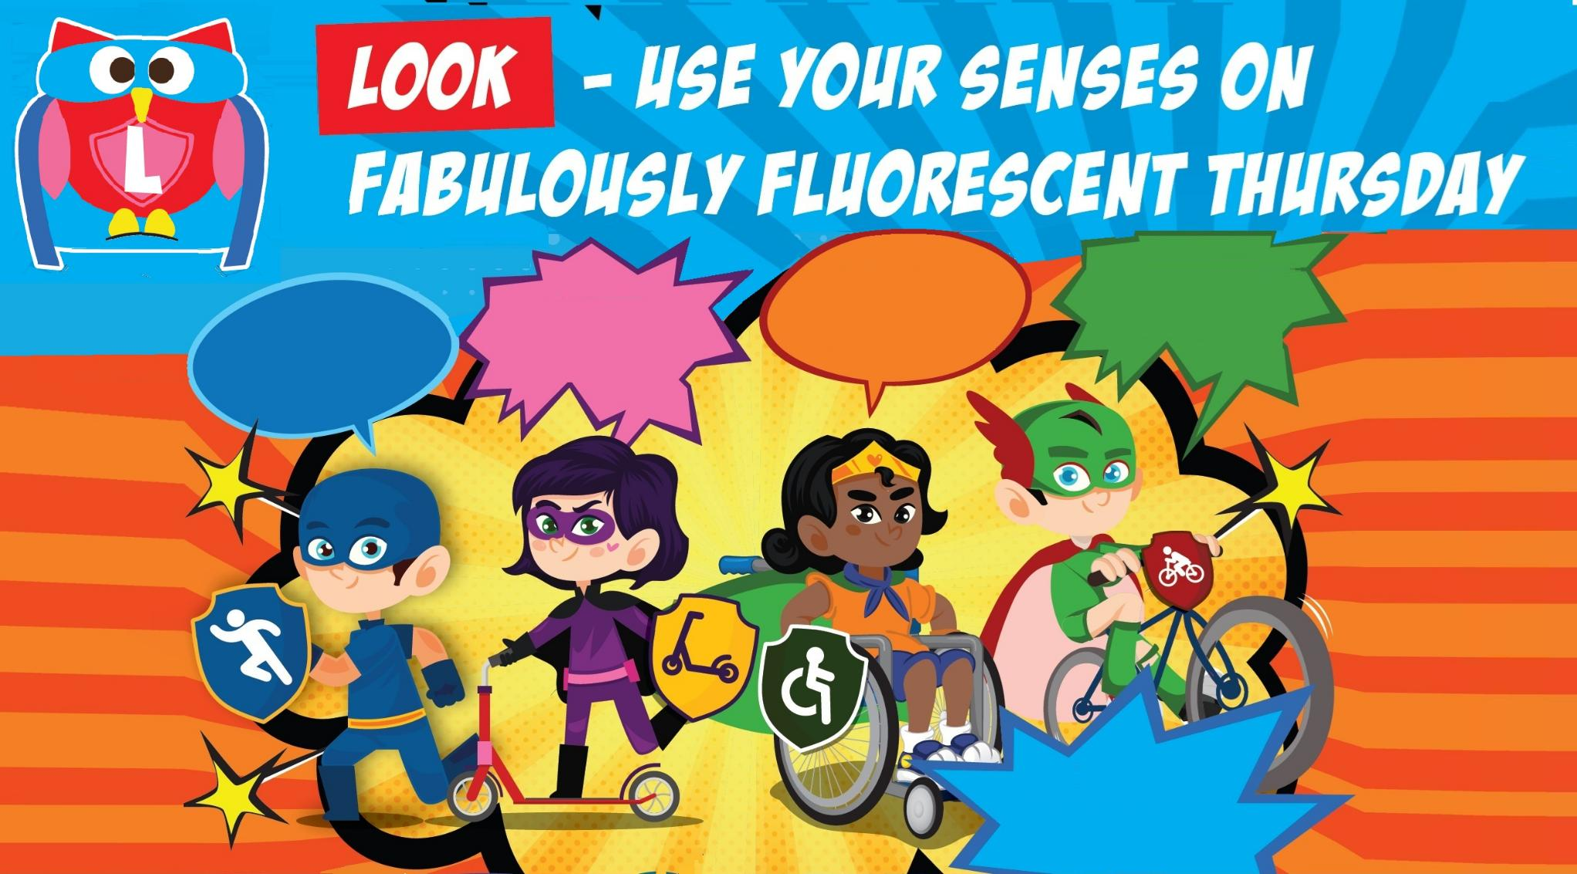
Look – use your senses on fabulously fluorescent Thursday
Add some bling to your wheels or heels to help you be seen.
Remember to
stop, look and listen when you are
near the road.
Stand out from the crowd with brilliant brightness!
Design your look!
Maybe design a helmet to help protect your head too.

Slide 8







Support others on Fantastic Fume Free Friday
Look how being a Travel Smart superhero is helping you and others in the world around you!
stop, look and listen when crossing the road.
Follow the instructions of the crossing patrol or the light controlled crossing,
make sure your cycle or scooter is safe to ride,
make sure you use the correctly fitted car seat or seat belt if you are getting a lift in the car
see www.childcarseats.org.uk
Drivers should also remember not to leave the engine running while waiting and do not stop or park here;
To help keep roads clear of cars.
To help keep you fit and active.
To help keep the air clean and reduce your carbon footprint.
And of course, every good superhero needs a good night’s REST and to EAT WELL to fuel them up to win another day!
To keep everyone safe.

Slide 9


Send us your Travel Smart hero designs
Use all the ideas from each day
of Travel Smart Week
to create your own Travel Smart superhero!
You can share it with us via
X https://x.com/Be_Travel_Smart
Facebook https://www.facebook.com/travelsmartderbyshire
or via email
sustainable.travel@derbyshire.gov.uk
We’d love to see your designs!

Slide 10
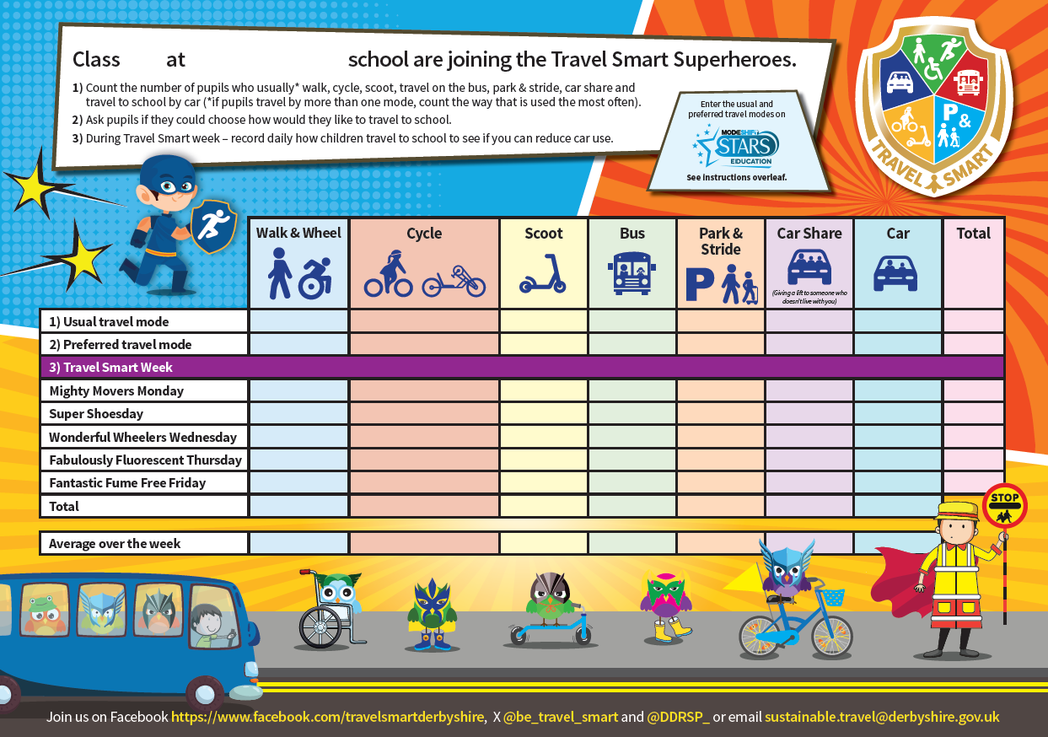
Remember to record how you travel
Remember to record how you usually travel to school and how you would like to travel.
Then compare this to how you make your journey in Travel Smart week to see if being a superhero makes a difference!

