Slide 1
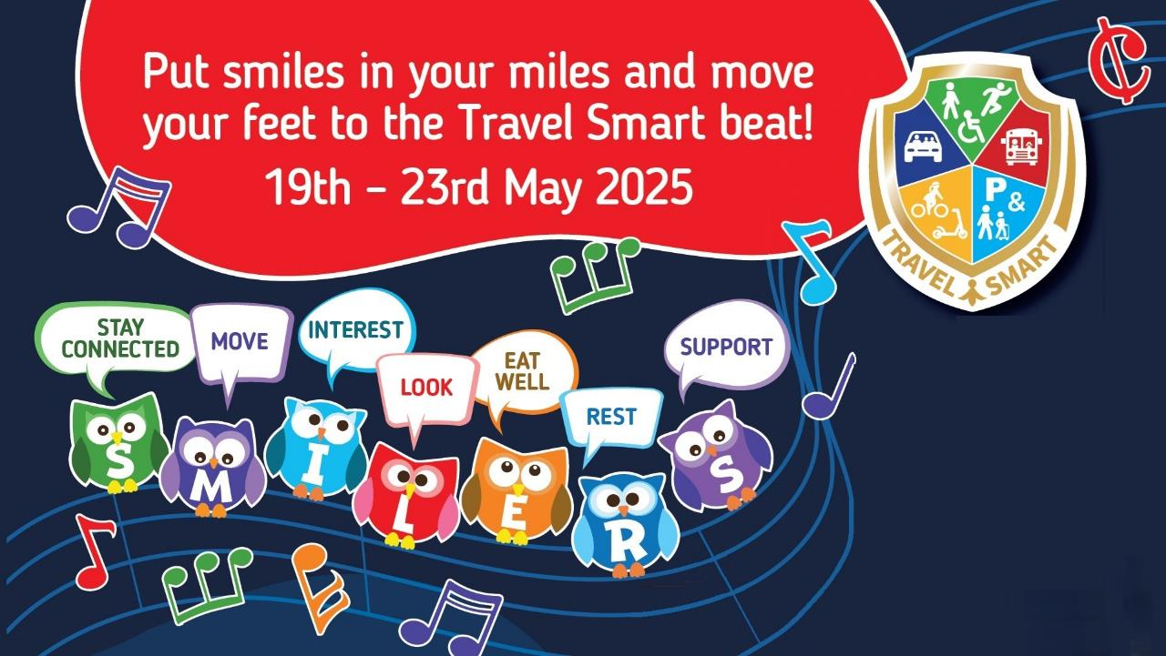

Put smiles in your miles and move your feet to the Travel Smart beat
Join the SMILERS and be a groovy mover on your school journey, to help boost your wellbeing, support your community and help the planet too!
Travel Smart week is supported by The Public Heath Grant

Slide 2

The & ways to Wellbeing
The 7 Ways To Wellbeing
Stay Connected. Having healthy relationships with people, pets and nature to help you to feel happy.
Move. Being active releases chemicals in your brain which boosts your mood and makes you feel good.
Interest. Having special interests and learning something new to help keep your brain busy.
Look. Using your senses to notice what is around you to keep you in the moment.
Eat well. Eating a balanced diet to make you feel good and help you stay healthy and strong.
Rest. Getting a good night’s sleep to improve your memory, mood and mental health.
Support. Supporting others to make us feel positive and to make them happy too!

Slide 3

Ways to make a journey
Ways To Make A Journey
Walk or Wheel
Carshare
Bus or Train
Park and
Stride or Glide
Cycle or Scoot

Slide 4


Music can help us get in the mood for moving and can play an important part in supporting our health and wellbeing.
Can you think of any travel and wellbeing themed songs?

Slide 5
Find out more about the SMILERS ways to Travel Smart and look for the clues to the tunes we have on our playlist that make us smile for miles!
If you click on a CD cover or other clue it will take you to the song!

Slide 6




Stay connected Monday
‘Flock together like birds of a feather’ as part of the Travel Smart family!
Share, sing and chat about the songs which make you happy
with the friends and grown-ups you travel with.
Pharrell Williams
Verna Hills

Slide 7
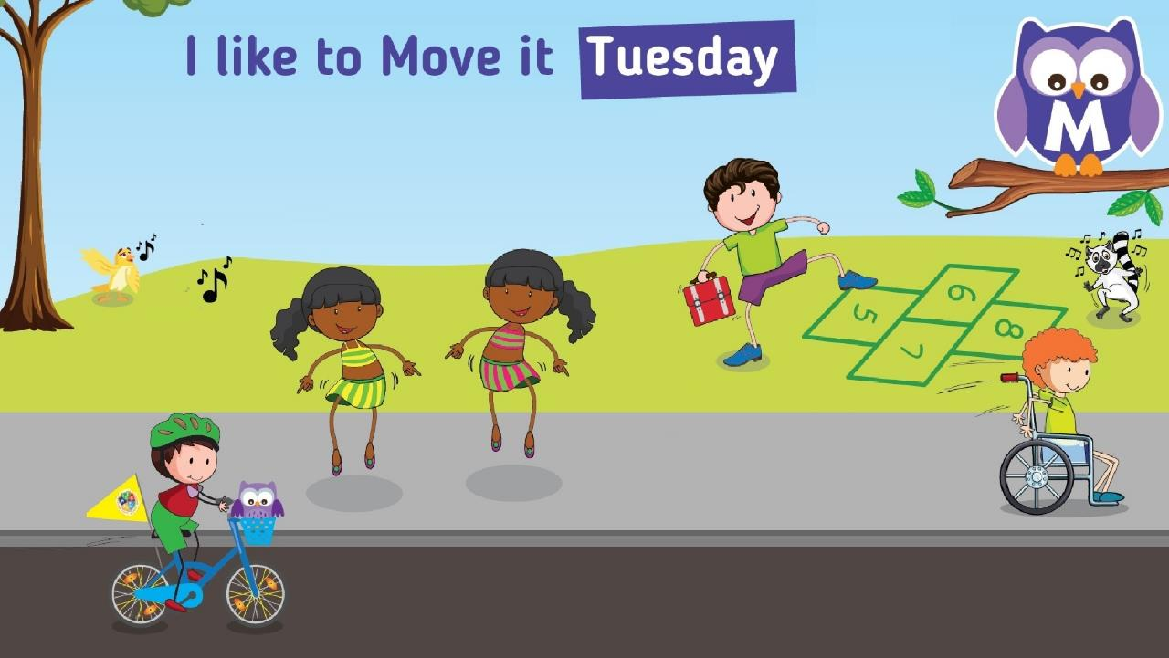







I like to move it Tuesday
Move it, shake it off, jump, stomp, hopscotch or cause a chain reaction as you get
spinning around on your wheels.
Diana Ross

Slide 8
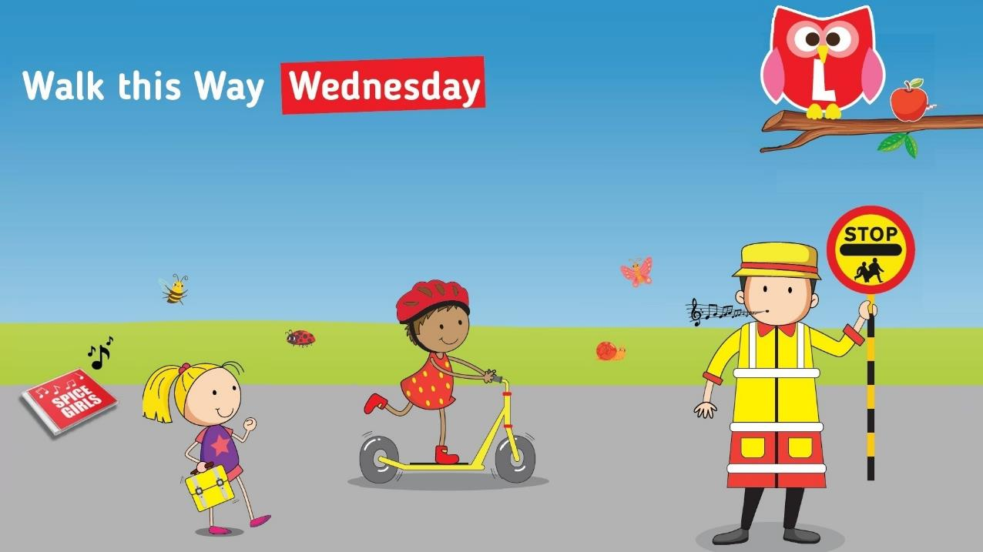




Walk this Way Wednesday
Remember to keep your senses tuned.
Stop, look out and listen for traffic when you get to the roadside.
Look out for each other and for safer places to cross.
Listen out for sounds of instruction too.
GIRLS
ALOUD

Slide 9
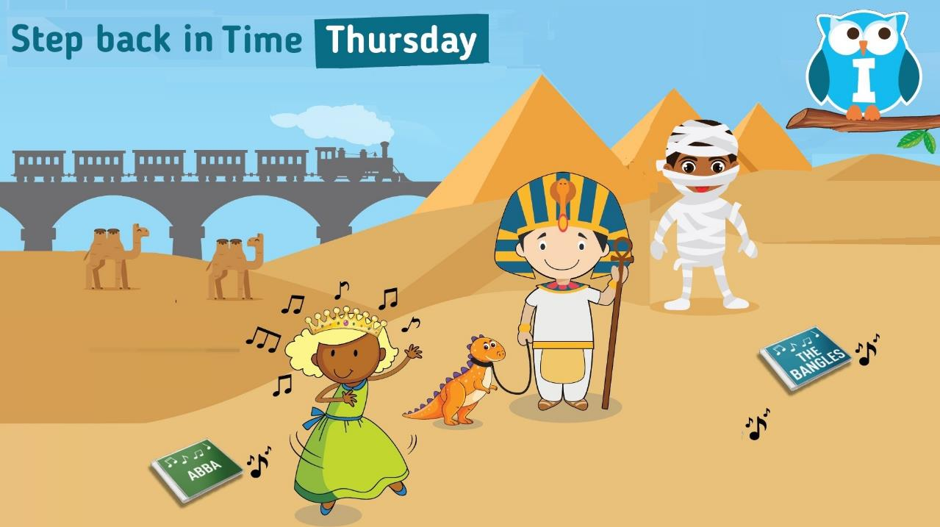





Step back in Time Thursday
Go time travelling to find out interesting and fascinating facts about journeys in the past.
LITTLE
EVA

Slide 10
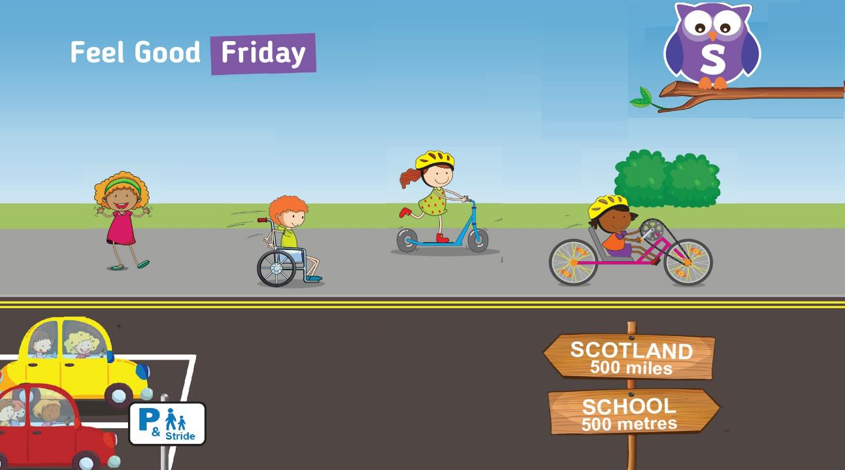



Feel Good Friday
Switch off when you drop off!
Park away from school and go walking on sunshine for a fume free Friday that helps everyone smile and feel good!
THE
Supernaturals

Slide 11
It’s important to remember to stay safe on your Travel Smart school journey!
It’s important to remember to stay safe on your Travel Smart school journey!
Find out more about the wise ways to staying safer as you Travel Smart

Slide 12
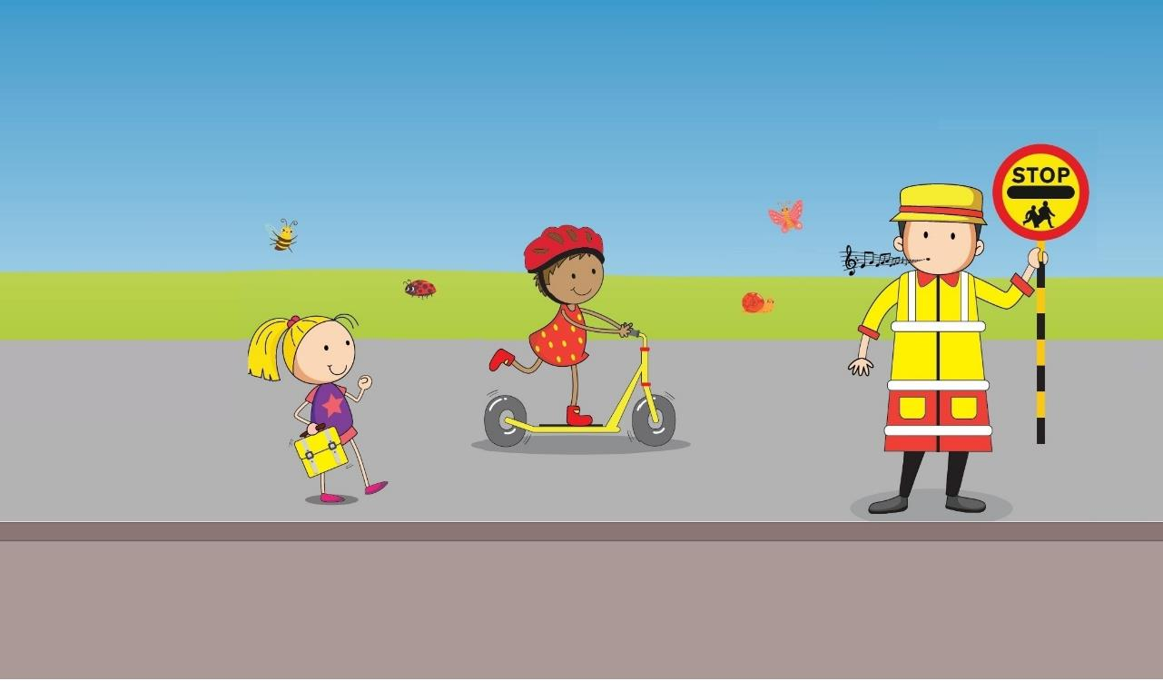


How to be pavement wise
How to be Pavement Wise
Remember to stop, look and listen when you cross the road.
If there is one available, use a zebra, light controlled or school crossing patrol to help you.
If you are scooting on the pavement look out for each other as well as other walkers and wheelers.

Slide 13
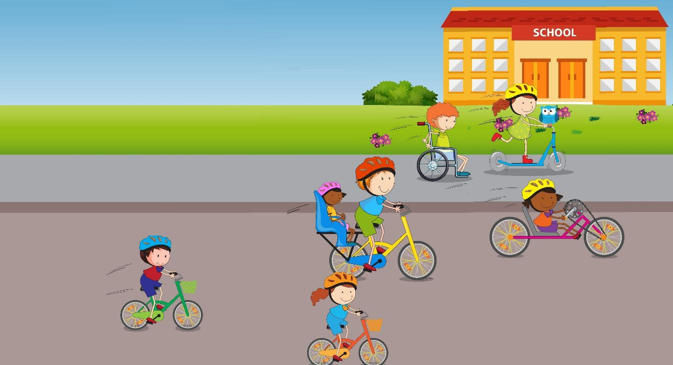

How to be a wise wheeler
How to be a Wise Wheeler
Make sure you and your wheels are safe to roll, check your brakes steering and tyres.
If you are scooting or cycling think about wearing a helmet.
Take care near driveways and look out for other pavement users.

Slide 14
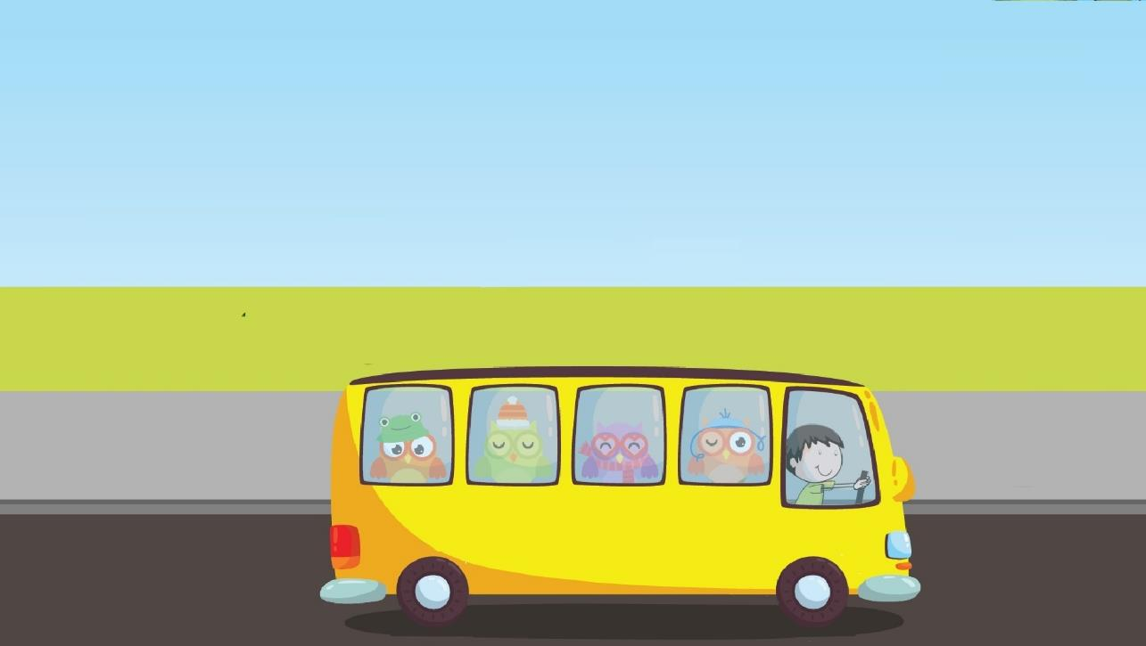

How to be a wise passenger
How to be a Wise Passenger
Always listen to the driver when they ask you to use a car seat or seat belt to help keep you safe.
Don’t distract the driver by messing about with other passengers.
Be aware of other vehicles when getting off the bus or out of the car.

Slide 15
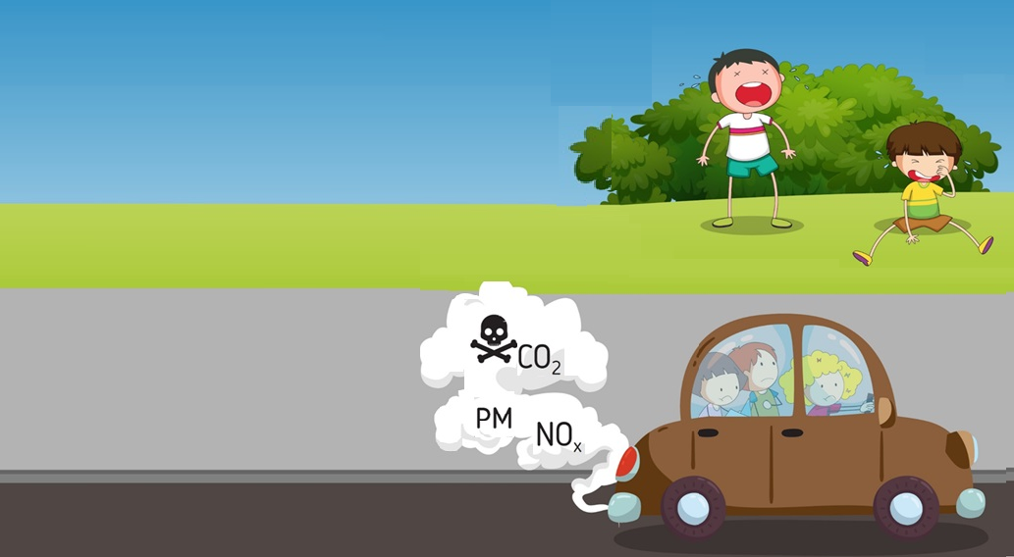

How to Park Wise
How to Park Wise
Remind the driver not to stop or park on the yellow zig zag lines.
Park away from school and walk or wheel the last distance if you can.
Remind the driver not to park on the pavement and not to block dropped kerbs and driveways.
Remind the driver to turn the engine off when waiting.
SCHOOL KEEP CLEAR

Slide 16

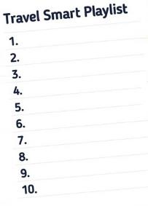
Have a great Travel Smart week moving your feet to the Travel Smart beat!
Have a great Travel Smart week moving your feet
to the Travel Smart beat!
Share your top 10 playlist that helps put the
smiles in your miles
@be_travel_smart
#TravelSmartTunes

