Slide 1
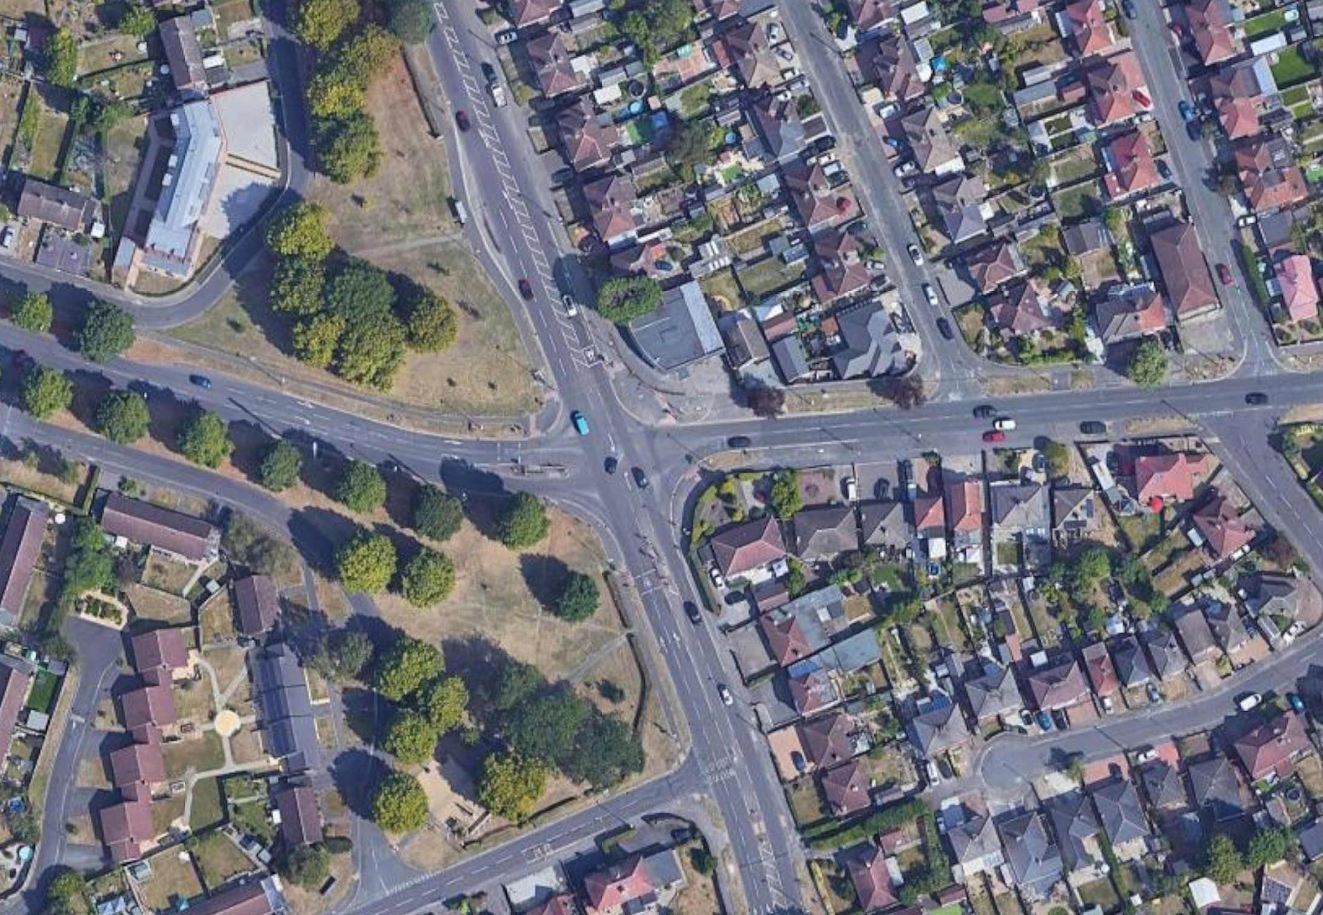



A514 CHELLASTON ROAD/MERRILL WAY/BOULTON LANE TRAFFIC MANAGEMENT PHASING PLANS
CHADWICK AVENUE
A514 CHELLASTON ROAD
Footways Closed
MERRILL WAY
BOULTON LANE
Phase 2 – Duration 10/1/26 – end Feb
4-way Temporary Lights
Approximate Working Areas
Footway Closed
Temporary Footway
Pedestrian Route/Walkway
A514 CHELLASTON ROAD
Controlled Pedestrian Crossing
All equipment positions are approximate.

Slide 2
CHADWICK AVENUE
A514 CHELLASTON ROAD
Footways Closed
MERRILL WAY
BOULTON LANE
Phase 2A – Duration end Feb to end March/early April
4-way Temporary Lights
Approximate Working Areas
Footway Closed
Temporary Footway
Pedestrian Route/Walkway
A514 CHELLASTON ROAD
Controlled Pedestrian Crossing
All equipment positions are approximate.

