Slide 1
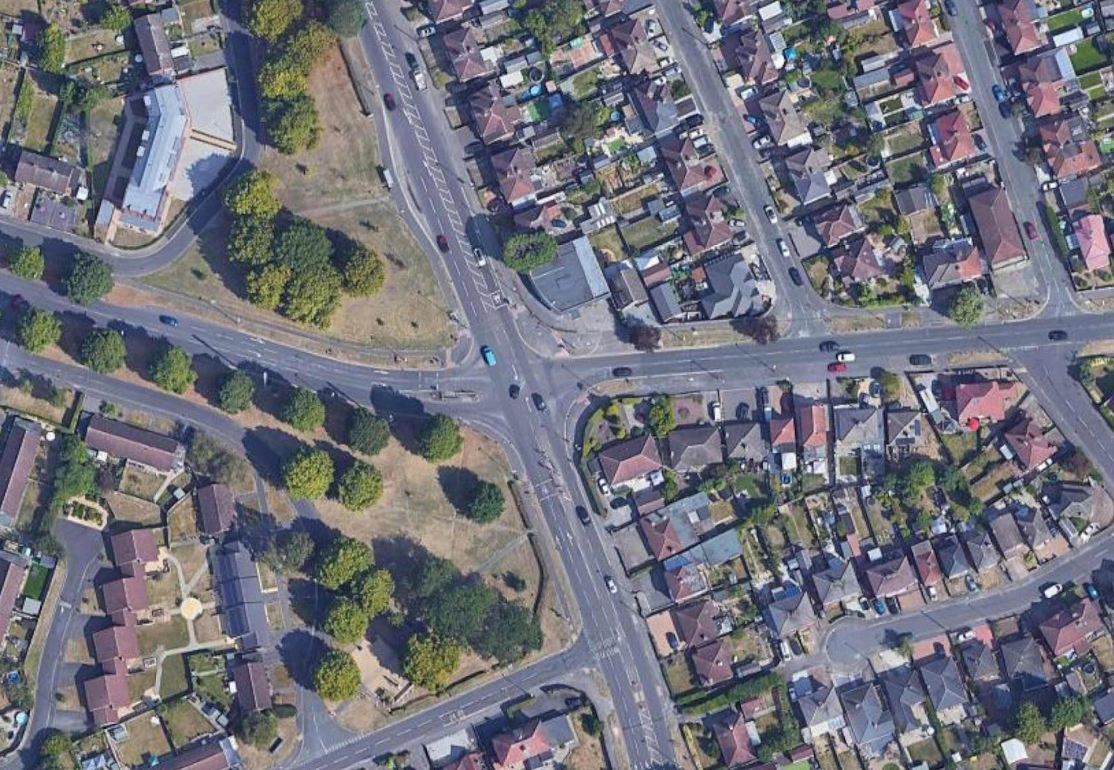



A514 CHELLASTON ROAD/MERRILL WAY/BOULTON LANE TRAFFIC MANAGEMENT PHASING PLANS
CHADWICK AVENUE
A514 CHELLASTON ROAD
A514 CHELLASTON ROAD
Footways Closed
MERRILL WAY
MERRILL WAY
MERRILL WAY
BOULTON LANE
Phase 2 and 2B running concurrently – 6/4/26 to 27/4/26
Approximate Working Areas
Footway Closed
Footway Closed
Temporary Footway
4-way Temporary Lights
Pedestrian Route/Walkway
A514 CHELLASTON ROAD
All equipment positions are approximate.

Slide 2
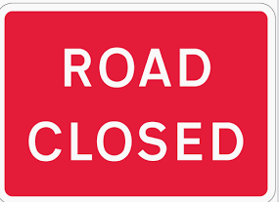
3-way Temporary Lights
CHADWICK AVENUE
A514 CHELLASTON ROAD
Footways Closed
MERRILL WAY
MERRILL WAY
Phase 2 and 2C running concurrently – Boulton Lane/Chadwick Avenue 24/7 closure 27/4/26 to 1/6/26 (5 weeks)
BOULTON LANE
Footway Closed
Approximate Working Areas
Boulton Lane/Chadwick Avenue Closures - signed diversion route will be Chellaston Road, Upper Moor Road, Bracken Lane, Boulton Lane and visa-versa.
Temporary Footway
Pedestrian Route/Walkway
A514 CHELLASTON ROAD
All equipment positions are approximate.

Slide 3
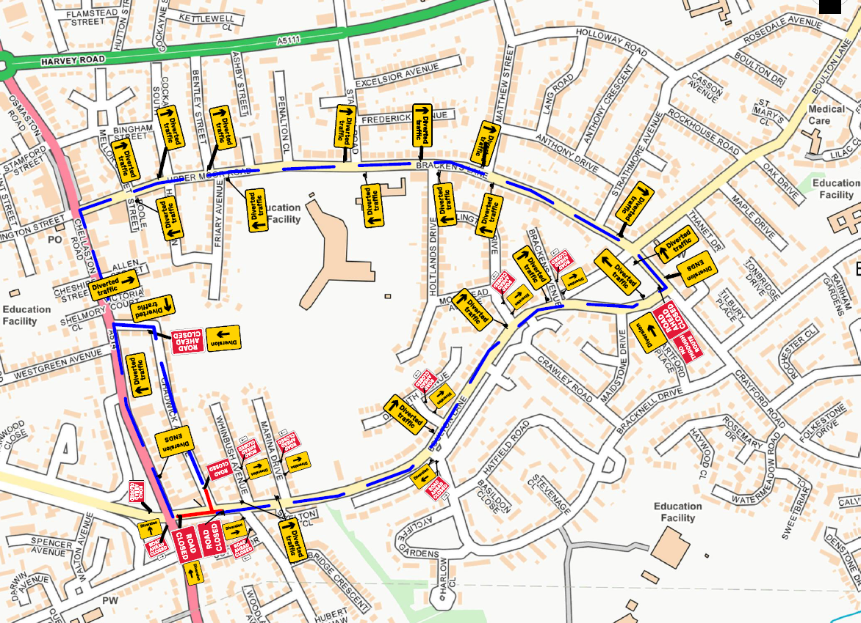
BOULTON LANE/CHADWICK AVENUE CLOSURES DIVERSION ROUTE
Boulton Lane/Chadwick Avenue Closures - signed diversion route will be Chellaston Road, Upper Moor Road, Bracken Lane, Boulton Lane and visa-versa.

